Slide 1






Algae Biofuels –
from dream to design, to demo.
Frank Rogalla
& Zouhayr Arbib

Slide 2

Considerations
Máster Universitario en Biotecnología
Industrial y Ambiental
Wastewater, Energy & other low cost products
5 Keypoints
Low CAPEX
PBRs
Low OPEX
process
No fertilizers
keep it simple
Human needs
Avoid closed systems
Net Energy Ratio > 1
Recycle N & P
Of course not!!
you can´t afford it
1st and 2nd
Generation biofuels
CO2
or not CO2

Slide 3
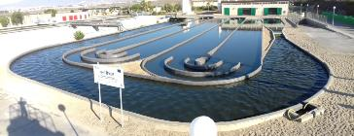

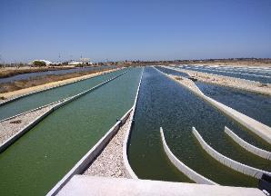
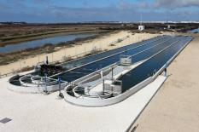
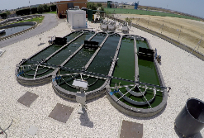
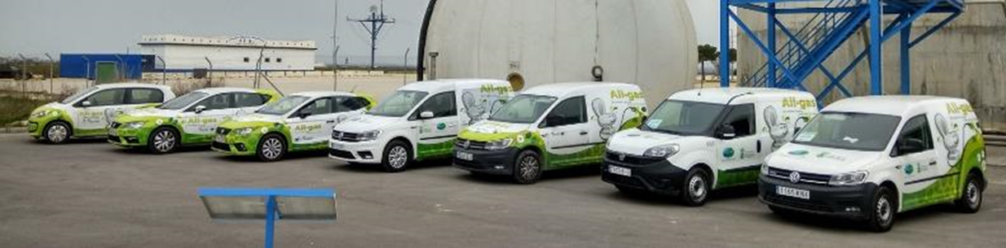

Risks
Scale up
Lab scale
DEMO
> 5000 m2
Prototype
500 m2
Pilot plant
6 x 32 m2
Pre-Demo
3000 m2

Slide 4


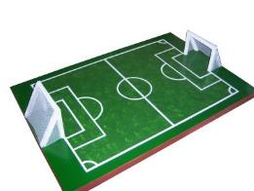


from dream to design, to demo
1 hectare demonstration plant: POTENTIAL
5000 PE
Simultaneous
N, P, COD & TSS removal
Below directive 91/271/EC
1000
m3/d WW
950 m3/d Reuse
- 0,3kWh/m3
>100 Ton/ yr
13,000 kg CH4/yr
40-60 Ton/ yr biomass
15 000 kg / 4,5 =
330.000 km
15 000 km/yr
22 cars
Energy saving
106.800
kWh/yr
50-60% VS
bio-CH4

Slide 5
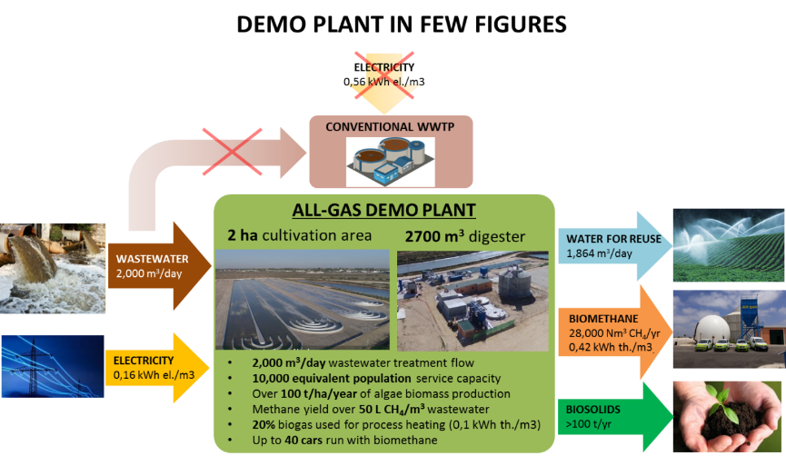

from dream to design, to demo
LCA Balance 2 hectares plant
  Complete LCA using GaBI software:
ENERGY RETURN ON INVESTMENT:
$$EROI=\frac{Energy output}{Energy input}=3.97$$

Slide 6
Conclusions
Simultaneous Resource Recovery and Biofuel Production: Circular Economy
Low CAPEX : HRAP
Size matters: HRAP > 5000 m2
Species not controllable in open systems
Recycle Nutrients (N&P)
CO₂ is not for free – avoid injection
KEEP it simple
Harvesting as bottleneck – low energy DAF
June 29 Online Course on Algae Biotecnology at U. Almeria
https://miriadax.net/web/biotecnologia-de-microalgas-3-edicion-/inicio

Slide 7

Upscaling algae
technologies for wastewater resource recovery:
Algae Biofuels = methane, fertiliser… food ?
Frogalla@FCC.es
& zouhayr.arbib@fcc.es

